Slide 1
Design and Implementation of a Face Recognition System for 10 Individuals
Course: CSE445 | Group Project

Slide 2
Group Information
K.M. Rayed Zakwan - 2231678642
Md. Mofidul Hassan - 2231018642
Md. Shahadat Hossain-2232195042
Barshon Basak - 2311625042

Slide 3
Abstract
• Face recognition is widely used in security, authentication, and HCI.
• We built a system for recognizing 10 individuals.
• Techniques: PCA, KNN, SVM & FaceNet embeddings.
• The system achieved promising accuracy; FaceNet provided the best performance.

Slide 4
Introduction
Face recognition: Non-intrusive biometric technology.
Objective: Build a system to detect, process, and classify 10 individuals.
Contributions: Preprocessing pipeline, PCA, KNN vs. SVM comparison.

Slide 5
Related Work
Early Approaches: Geometric feature-based.
• PCA/Eigenfaces pioneered classical face recognition.
• Deep learning (CNN, FaceNet) is now dominant in large-scale systems.
• We adapt classical and deep methods for small dataset.

Slide 6
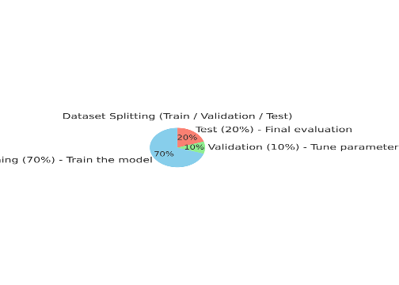
Dataset
• Dataset self-created (10 individuals).
• Photos captured under different poses, expressions, and lighting.
• Images resized to 64×64 and converted to grayscale.
Dataset split: 70% train, 10% validation, 20% test.

Slide 7
Preprocessing
• Face detection & alignment using MTCNN (+25% margin).
• Normalization of pixel values.
Two pipelines:
Grayscale → PCA → KNN/SVM.
RGB → FaceNet → KNN.

Slide 8
Models Used
KNN: Distance-based, interpretable, baseline model.
SVM: Margin-based, better generalization on PCA features.
• Both are suited for small datasets;
SVM is more robust to outliers.

Slide 9
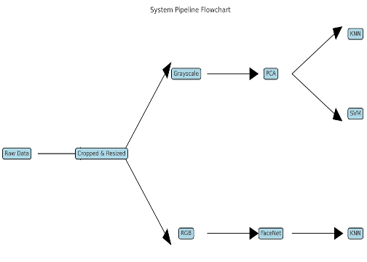
Implementation
• Split data into train (70%), validation (10%), and test (20%).
• Applied PCA only after split to avoid data leakage.
• KNN with threshold τ for unknown detection.
• PCA+KNN and PCA+SVM implemented manually.
• FaceNet embeddings classified with CNN.

Slide 10
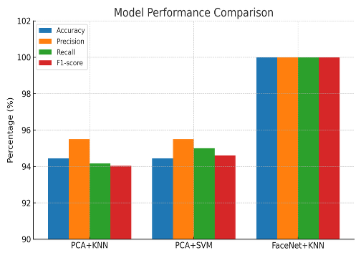
Results
Metrics: Accuracy, Precision, Recall, F1-score.
• PCA+KNN → Acc: 94.44%, F1: 94.03%.
• PCA+SVM → Acc: 94.44%, F1: 94.60%.
• FaceNet+KNN → Acc: 100%, F1: 100%.
FaceNet drastically outperformed classical methods.

Slide 11
Discussion
• PCA+KNN: Simple and effective but sensitive to noise.
• PCA+SVM: More balanced and robust than KNN.
• FaceNet+KNN: Excellent performance, embeddings well-separated.
• Challenges: Lighting variation, occlusions, minor pose shifts.
Classical methods are useful for learning, but deep embeddings are best.

Slide 12
Conclusion & Future Work
• The system successfully recognized 10 individuals.
• Classical ML models showed feasibility for small-scale tasks.
• FaceNet embeddings gave state-of-the-art accuracy.
Future Work: Expand dataset, adopt CNN-based models, and deploy in real-time apps.

Slide 13
Thank you.

